Slide 1
String Functions in Python

Slide 2
Python has several built-in functions associated with the string data type. These functions let us easily modify and manipulate strings. We can think of functions as being actions that we perform on elements of our code. Built-in functions are those that are defined in the Python programming language and are readily available for us to use.
Making Strings Upper and Lower Case
The functions str.upper() and str.lower() will return a string with all the letters of an original string converted to upper- or lower-case letters. Because strings are immutable data types, the returned string will be a new string. Any characters in the string that are not letters will not be changed.

Slide 3
ss = "Sammy Shark"
print(ss.upper())
Ouput
SAMMY SHARK
Now, let’s convert the string to be all lower case:
print(ss.lower())
Ouput
sammy shark
The str.upper() and str.lower() functions make it easier to evaluate and compare strings by making case consistent throughout. That way if a user writes their name all lower case, we can still determine whether their name is in our database by checking it against all upper-case version.

Slide 4
Boolean Methods
Python has some string methods that will evaluate to a Boolean value. These methods are useful when we are creating forms for users to fill in, for example. If we are asking for a post code we will only want to accept a numeric string, but when we are asking for a name, we will only want to accept an alphabetic string.
There are a number of string methods that will return Boolean values:

Slide 5
Method True if
str.isalnum() String consists of only alphanumeric characters (no symbols)
str.isalpha() String consists of only alphabetic characters (no symbols)
str.islower() String’s alphabetic characters are all lower case
str.isnumeric() String consists of only numeric characters
str.isspace() String consists of only whitespace characters
str.istitle() String is in title case
str.isupper() String’s alphabetic characters are all upper case

Slide 6
number = "5"
letters = "abcdef"
print(number.isnumeric())
print(letters.isnumeric())
Output
True
False

Slide 7
We can query whether a string’s alphabetic characters are in title case, upper case, or lower case. Let’s create a few strings:
movie = "2001: A SAMMY ODYSSEY"
book = "A Thousand Splendid Sharks"
poem = "sammy lived in a pretty how town"
Now let’s try the Boolean methods that check for case:
print(movie.islower())
print(movie.isupper())
print(book.istitle())
print(book.isupper())
print(poem.istitle())
print(poem.islower())

Slide 8
Now we can run these small programs and see the output:
Output of movie string
False
True
Output of book string
True
False
Output of poem string
False
True

Slide 9
Determining String Length
The string function len() returns the number of characters in a string. This method is useful for when you need to enforce minimum or maximum password lengths, or to truncate larger strings to be within certain limits for use as abbreviations.
open_source = "Sammy contributes to open source."
print(len(open_source))
Output
33

Slide 10
join(), split(), and replace() Methods
The str.join(), str.split(), and str.replace() methods are a few additional ways to manipulate strings in Python.
The str.join() method will concatenate two strings, but in a way that passes one string through another.
Let’s create a string:
balloon = "Sammy has a balloon.“
Now, let’s use the str.join() method to add whitespace to that string print(" ".join(balloon))
We will see that in the new string that is returned there is added space throughout the first string:
Output
S a m m y h a s a b a l l o o n .

Slide 11
We can also use the str.join() method to return a string that is a reversal from the original string:
print("".join(reversed(balloon)))
Output
.noollab a sah ymmaS
We did not want to add any part of another string to the first string, so we kept the quotation marks touching with no space in between.

Slide 12
The str.join() method is also useful to combine a list of strings into a new single string.
Let’s create a comma-separated string from a list of strings:
print(",".join(["sharks", "crustaceans", "plankton"]))
Output
sharks,crustaceans,plankton
If we want to add a comma and a space between string values in our new string, we can simply rewrite our expression with a whitespace after the comma: ", ".join(["sharks", "crustaceans", "plankton"]).

Slide 13
Just as we can join strings together, we can also split strings up. To do this, we will use the str.split() method:
print(balloon.split())
Output
['Sammy', 'has', 'a', 'balloon.']
The str.split() method returns a list of strings that are separated by whitespace if no other parameter is given.
We can also use str.split() to remove certain parts of an original string. For example, let’s remove the letter a from the string:
print(balloon.split("a"))
Output
['S', 'mmy h', 's ', ' b', 'lloon.']
Now the letter a has been removed and the strings have been separated where each instance of the letter a had been, with whitespace retained.

Slide 14
The str.replace() method can take an original string and return an updated string with some replacement.
Let’s say that the balloon that Sammy had, is lost. Since Sammy no longer has this balloon, we will change the substring "has" from the original string balloon to "had" in a new string:
print(balloon.replace("has","had"))
Within the parentheses, the first substring is what we want to be replaced, and the second substring is what we are replacing that first substring with. Our output will look like this:
Output
Sammy had a balloon.
Using the string methods str.join(), str.split(), and str.replace() will provide you with greater control to manipulate strings in Python.

Slide 15
Strings are amongst the most popular types in Python. We can create them simply by enclosing characters in quotes. Python treats single quotes the same as double quotes. Creating strings is as simple as assigning a value to a variable. For example
var1 = 'Hello World!'
var2 = "Python Programming"
Accessing Values in Strings
Python does not support a character type; these are treated as strings of length one, thus also considered a substring.
To access substrings, use the square brackets for slicing along with the index or indices to obtain your substring. For example −

Slide 16
var1 = 'Hello World!'
var2 = "Python Programming"
print ("var1[0]: ", var1[0])
print ("var2[1:5]: ", var2[1:5])
Output
var1[0]: H
var2[1:5]: ytho

Slide 17
Updating Strings
You can "update" an existing string by (re)assigning a variable to another string. The new value can be related to its previous value or to a completely different string altogether. For example −
var1 = 'Hello World!'
print ("Updated String :- ", var1[:6] + 'Python’)
Output
Updated String :- Hello Python

Slide 18
Escape Characters
Following table is a list of escape or non-printable characters that can be represented with backslash notation.
An escape character gets interpreted; in a single quoted as well as double quoted strings.

Slide 19
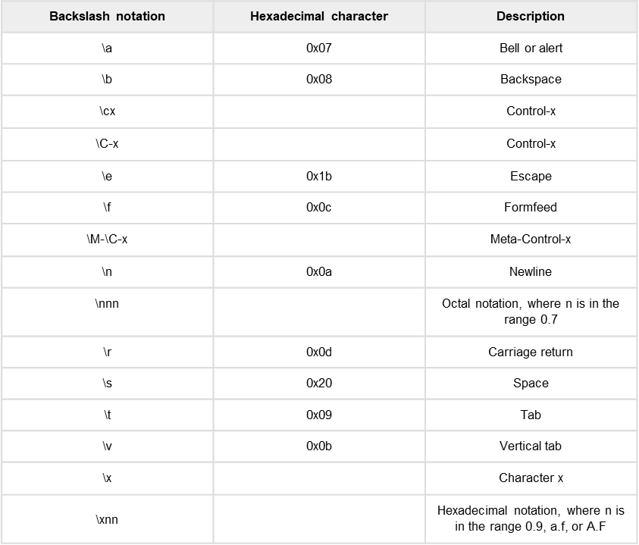

Slide 20
String Special Operators
Assume string variable a holds 'Hello' and variable b holds 'Python', then −

Slide 22
A Python raw string is a normal string, prefixed with a r or R.
This treats characters such as backslash (‘\’) as a literal character. This also means that this character will not be treated as a escape character.
s="Hello\tfrom AskPython\nHi"
print(s)
Python raw string is created by prefixing a string literal with ‘r’ or ‘R’. Python raw string treats backslash (\) as a literal character. This is useful when we want to have a string that contains backslash and don’t want it to be treated as an escape character.

Slide 23
String Formatting Operator
One of Python's coolest features is the string format operator %. This operator is unique to strings and makes up for the pack of having functions from C's printf() family. Following is a simple example −
print ("My name is %s and weight is %d kg!" % ('Zara', 21))
My name is Zara and weight is 21 kg!

Slide 26
Python String
In Python, Strings are arrays of bytes representing Unicode characters. However, Python does not have a character data type, a single character is simply a string with a length of 1. Square brackets can be used to access elements of the string.
Creating a String
Strings in Python can be created using single quotes or double quotes or even triple quotes.
# Python Program for Creation of String with single Quotes
String1 = 'Welcome to the Beautiful World'
print("String with the use of Single Quotes: ")
print(String1)
Output
String with the use of Single Quotes:
Welcome to the Beautiful World

Slide 27
# Creating a String
# with double Quotes
String1 = "I'm a student"
print("\nString with the use of Double Quotes: ")
print(String1)
Output
String with the use of Double Quotes:
I'm a student

Slide 28
# Creating a String
# with triple Quotes
String1 = '''I'm a student and I live in a world of “Computer"'''
print("\nString with the use of Triple Quotes: ")
print(String1)
Output
String with the use of Triple Quotes:
I'm a student and I live in a world of “Computer"

Slide 29
# Creating String with triple
# Quotes allows multiple lines
String1 = ‘‘’Student
For
Life'''
print("\nCreating a multiline String: ")
print(String1)
Output
Creating a multiline String:
Student
For
Life

Slide 30
Accessing characters in Python
In Python, individual characters of a String can be accessed by using the method of Indexing. Indexing allows negative address references to access characters from the back of the String, e.g. -1 refers to the last character, -2 refers to the second last character and so on.
While accessing an index out of the range will cause an IndexError. Only Integers are allowed to be passed as an index, float or other types will cause a TypeError
W | E | L | C | O | M | E
0 | 1 | 2 | 3 | 4 | 5 | 6
-7 | -6 | -5 | -4 | -3 | -2 | -1

Slide 31
# Printing First character
String1 = “WELCOME"
print("\nFirst character of String is: ")
print(String1[0])
Output
W
# Printing Last character
print("\nLast character of String is: ")
print(String1[-1])
Output
E

Slide 32
Python ord() function returns the Unicode code from a given character. This function accepts a string of unit length as an argument and returns the Unicode equivalence of the passed argument. In other words, given a string of length 1, the ord() function returns an integer representing the Unicode code point of the character when an argument is a Unicode object, or the value of the byte when the argument is an 8-bit string.
The chr() method returns a string representing a character whose Unicode code point is an integer.
The chr() method takes only one integer as argument.
The chr() method returns a character whose unicode point is num, an integer.
If an integer is passed that is outside the range then the method returns a ValueError.
str="Welcome to the world of python"
ch='R'
print(ord(ch))
print(chr(82))

Slide 33
Membership Operators
Membership operators are operators used to validate the membership of a value. It tests for membership in a sequence, such as strings, lists, or tuples.
in operator: The ‘in’ operator is used to check if a value exists in a sequence or not. Evaluate to true if it finds a variable in the specified sequence and false otherwise.

